Slide 1

Structured Query Language
DAVID M. KROENKE and DAVID J. AUER
DATABASE CONCEPTS, 7th Edition
Chapter Three

Slide 2
Chapter Objectives
Learn basic SQL statements for creating database structures
Learn basic SQL statements for adding data to a database
Learn basic SQL SELECT statements and options for processing a single table
Learn basic SQL SELECT statements for processing multiple tables with subqueries
Learn basic SQL SELECT statements for processing multiple tables with joins
Learn basic SQL statements for modifying and deleting data from a database
Learn basic SQL statements for modifying and deleting database tables and constraints

Slide 3
Structured Query Language
Structured Query Language
Acronym: SQL
Pronounced as “S-Q-L” [“Ess-Que-El”]
Originally developed by IBM as the SEQUEL language in the 1970s
SQL-92 is an ANSI national standard adopted in 1992.
SQL:2011 is current standard.

Slide 4
SQL Defined
SQL is not a programming language, but rather a data sublanguage.
SQL is comprised of
Data definition language (DDL)
Used to define database structures
Data manipulation language (DML)
Data definition and updating
Data retrieval (Queries)
SQL/Persistent Stored Modules (SQL/PSM)
Procedural programming capabilities [See Appendix E]
Transaction control language (TCL)
Control transaction behavior [See Chapter 6]
Data control language (DLC)
Grant and revoke database permissions [See Chapter 6]

Slide 5
SQL for Data Definition
The SQL data definition statements include:
CREATE
To create database objects
ALTER
To modify the structure and/or characteristics of database objects
DROP
To delete database objects
TRUNCATE
To delete table data while keeping structure

Slide 6
SQL for Data Definition: CREATE
Creating database tables
The SQL CREATE TABLE statement
CREATE TABLE EMPLOYEE(
EmpID Integer PRIMARY KEY,
EmpName Char(25) NOT NULL
);

Slide 7
SQL for Data Definition: CREATE with CONSTRAINT I
Creating database tables with PRIMARY KEY constraints
The SQL CREATE TABLE statement
The SQL CONSTRAINT keyword
CREATE TABLE EMPLOYEE(
EmpID Integer NOT NULL,
EmpName Char(25) NOT NULL
CONSTRAINT Emp_PK PRIMARY KEY(EmpID)
);

Slide 8
SQL for Data Definition: CREATE with CONSTRAINT II
Creating database tables with composite primary keys using PRIMARY KEY constraints
The SQL CREATE TABLE statement
The SQL CONSTRAINT keyword
CREATE TABLE EMP_SKILL(
EmpID Integer NOT NULL,
SkillID Integer NOT NULL,
SkillLevel Integer NULL,
CONSTRAINT EmpSkill_PK PRIMARY KEY
(EmpID, SkillID)
);

Slide 9
SQL for Data Definition: CREATE with CONSTRAINT III
Creating database tables using PRIMARY KEY and FOREIGN KEY constraints
The SQL CREATE TABLE statement
The SQL CONSTRAINT keyword
CREATE TABLE EMP_SKILL(
EmpID Integer NOT NULL,
SkillID Integer NOT NULL,
SkillLevel Integer NULL,
CONSTRAINT EmpSkill_PK PRIMARY KEY
(EmpID, SkillID),
CONSTRAINT Emp_FK FOREIGN KEY(EmpID)
REFERENCES EMPLOYEE(EmpID),
CONSTRAINT Skill_FK FOREIGN KEY(SkillID) REFERENCES SKILL(SkillID)
);

Slide 10
SQL for Data Definition: CREATE with CONSTRAINT IV
Creating database tables using PRIMARY KEY and FOREIGN KEY constraints
The SQL CREATE TABLE statement
The SQL CONSTRAINT keyword
ON UPDATE CASCADE and ON DELETE CASCADE
CREATE TABLE EMP_SKILL(
EmpID Integer NOT NULL,
SkillID Integer NOT NULL,
SkillLevel Integer NULL,
CONSTRAINT EmpSkill_PK PRIMARY KEY(EmpID, SkillID),
CONSTRAINT Emp_FK FOREIGN KEY(EmpID)
REFERENCES EMPLOYEE(EmpID)
ON DELETE CASCADE,
CONSTRAINT Skill_FK FOREIGN KEY(SkillID)
REFERENCES SKILL(SkillID)
ON UPDATE CASCADE
);

Slide 11
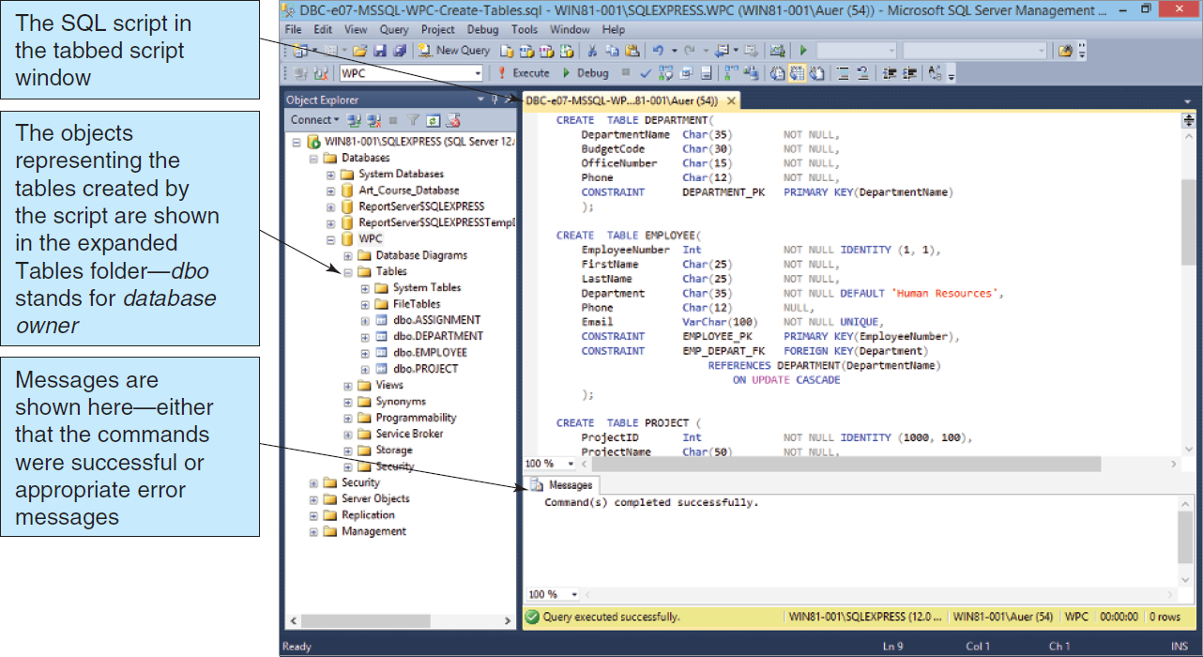
Process SQL CREATE TABLE Statements: Microsoft SQL Server 2014
Table 3-8: Processing the CREATE TABLE Statements Using SQL Server 2014

Slide 12
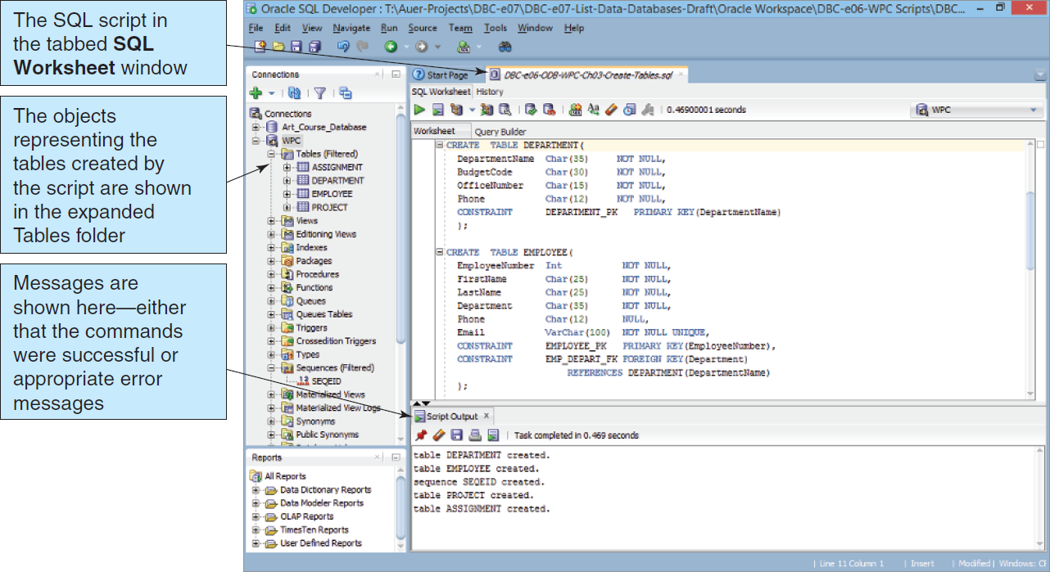
Process SQL CREATE TABLE Statements: Oracle Database 11g Release 2
Figure 3-9: Processing the CREATE TABLE Statements Using Oracle Database Express Edition 11g Release 2

Slide 13
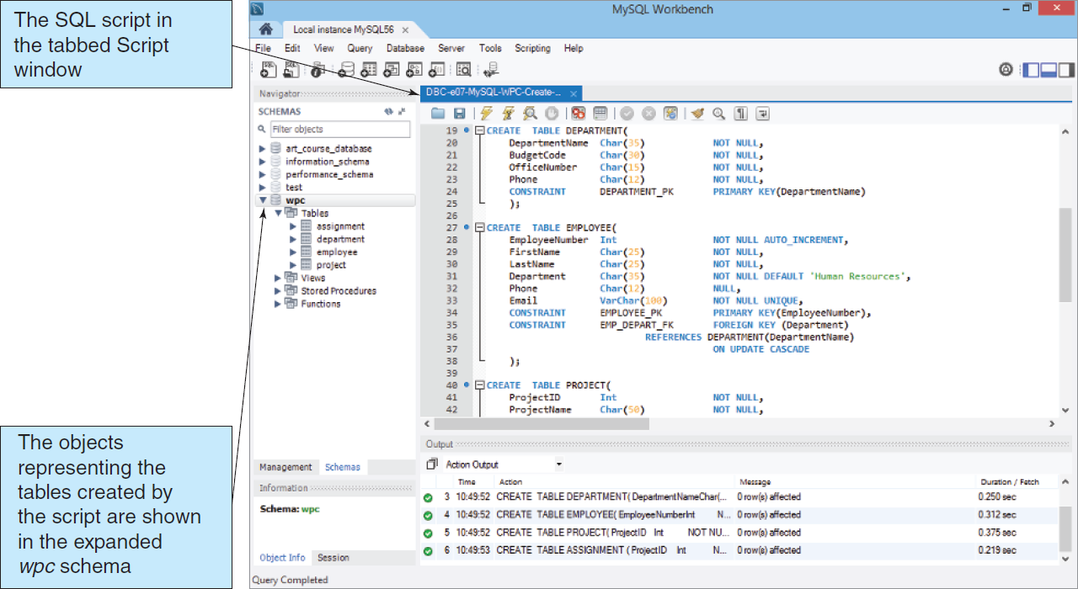
Process SQL CREATE TABLE Statements: MySQL 5.6
Figure 3-10: Processing the CREATE TABLE Statements Using MySQL 5.6

Slide 14
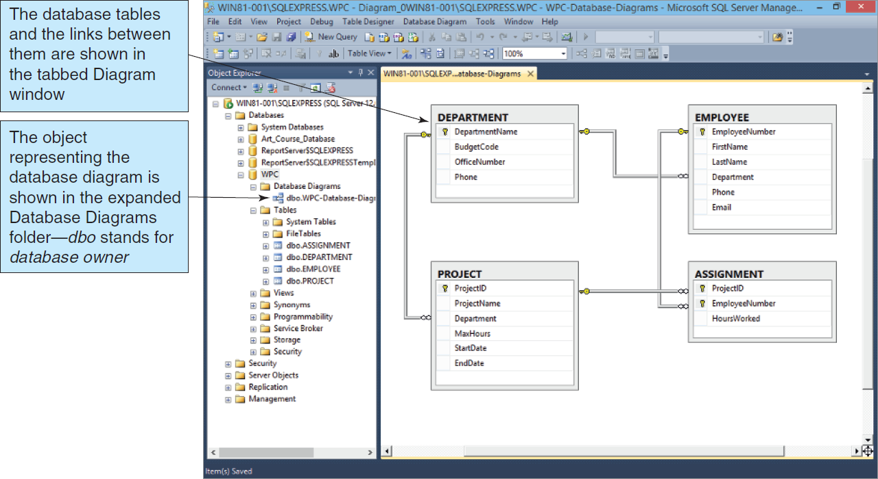
Database Diagram in the Microsoft SQL Server Management Studio
Figure 3-11: Database Diagram in the Microsoft SQL Server Management Studio

Slide 15
Primary Key Constraint: ALTER I
Adding primary key constraints to an existing table
The SQL ALTER statement
ALTER TABLE EMPLOYEE
ADD CONSTRAINT Emp_PK PRIMARY KEY(EmpID);

Slide 16
Composite Primary Key Constraints: ALTER II
Adding a composite primary key constraint to an existing table
The SQL ALTER statement
ALTER TABLE EMP_SKILL
ADD CONSTRAINT EmpSkill_PK
PRIMARY KEY(EmpID, SkillID);

Slide 17
Foreign Key Constraint: ALTER III
Adding foreign key constraints to an existing table
The SQL ALTER statement
ALTER TABLE EMPLOYEE ADD
CONSTRAINT Emp_FK FOREIGN KEY(DeptID)
REFERENCES DEPARTMENT(DeptID);

Slide 18
Adding Data: INSERT
To add a row to an existing table, use the INSERT statement.
Non-numeric data must be enclosed in straight ( ' ) single quotes.
INSERT INTO EMPLOYEE VALUES(91, 'Smither', 12);
INSERT INTO EMPLOYEE (EmpID, SalaryCode)
VALUES (62, 11);

Slide 19
SQL for Data Retrieval: Queries
SELECT is the best known SQL statement.
SELECT will retrieve information from the database that matches the specified criteria using the SELECT/FROM/WHERE framework.
SELECT EmpName
FROM EMPLOYEE
WHERE EmpID = 2010001;

Slide 20
SQL for Data Retrieval: The Results of a Query Is a Relation
A query pulls information from one or more relations and creates (temporarily) a new relation.
This allows a query to:
Create a new relation
Feed information to another query (as a “sub-query”)

Slide 21
SQL for Data Retrieval: Displaying All Columns
To show all of the column values for the rows that match the specified criteria, use an asterisk ( * ).
SELECT *
FROM EMPLOYEE;

Slide 22
SQL for Data Retrieval: Showing Each Row Only Once
The DISTINCT keyword may be added to the SELECT statement to inhibit duplicate rows from displaying.
SELECT DISTINCT DeptID
FROM EMPLOYEE;

Slide 23
SQL for Data Retrieval: Specifying Search Criteria
The WHERE clause stipulates the matching criteria for the record that is to be displayed.
SELECT EmpName
FROM EMPLOYEE
WHERE DeptID = 15;

Slide 24
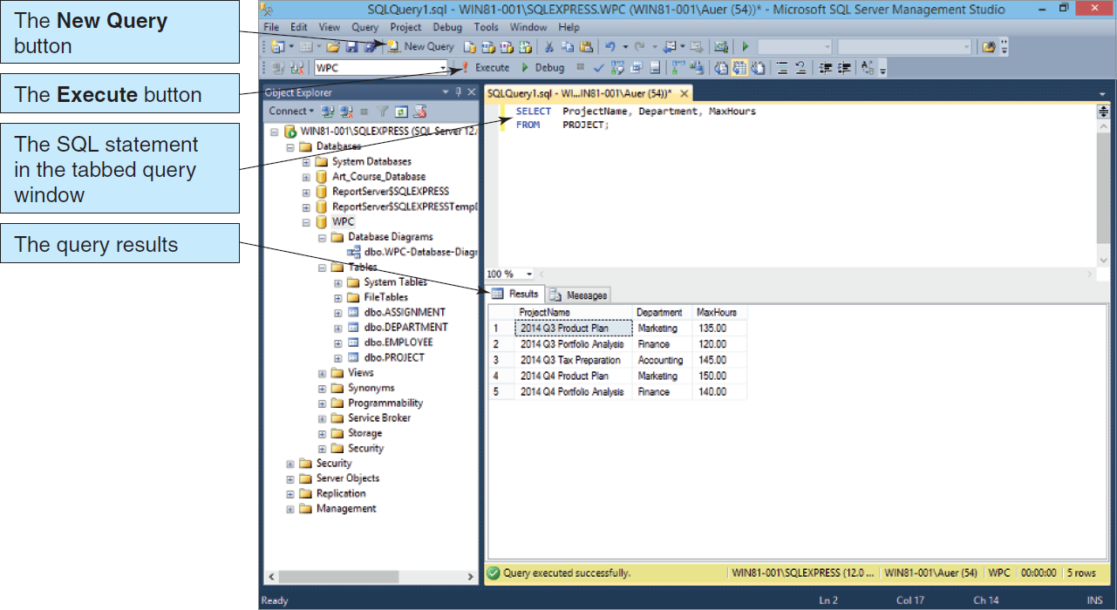
Processing SQL Query Statements: Microsoft SQL Server 2014
Figure 3-13: SQL Query Results in the Microsoft SQL Server Management Studio

Slide 25
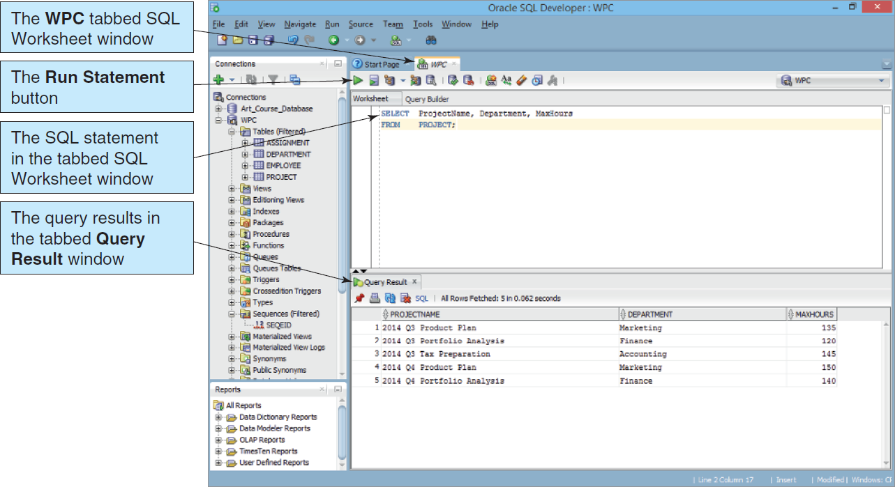
Processing SQL Query Statements: Oracle Database Express Edition 11g Release 2
Figure 3-14: SQL Query Results in the Oracle SQL Developer

Slide 26
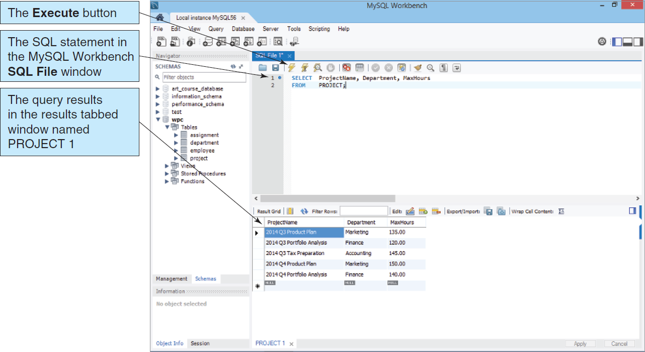
Processing SQL Query Statements: MySQL 5.6
Figure 3-15: SQL Query Results in the MySQL Workbench

Slide 27
SQL for Data Retrieval: Match Criteria
The WHERE clause match criteria may include
Equals “=”
Not Equals “<>”
Greater than “>”
Less than “<”
Greater than or Equal to “>=”
Less than or Equal to “<=”

Slide 28
SQL for Data Retrieval: Match Operators
Multiple matching criteria may be specified using
AND
Representing an intersection of the data sets
OR
Representing a union of the data sets

Slide 29
SQL for Data Retrieval: Operator Examples
SELECT EmpName
FROM EMPLOYEE
WHERE DeptID < 7
OR DeptID > 12;
SELECT EmpName
FROM EMPLOYEE
WHERE DeptID = 9
AND SalaryCode <= 23;

Slide 30
SQL for Data Retrieval: A List of Values
The WHERE clause may include the IN keyword to specify that a particular column value must be included in a list of values.
SELECT EmpName
FROM EMPLOYEE
WHERE DeptID IN (4, 8, 9);

Slide 31
SQL for Data Retrieval: The Logical NOT Operator
Any criteria statement may be preceded by a NOT operator, which is to say that all information will be shown except that information matching the specified criteria
SELECT EmpName
FROM EMPLOYEE
WHERE DeptID NOT IN (4, 8, 9);

Slide 32
SQL for Data Retrieval: Finding Data in a Range of Values
SQL provides a BETWEEN keyword that allows a user to specify a minimum and maximum value on one line.
SELECT EmpName
FROM EMPLOYEE
WHERE SalaryCode BETWEEN 10 AND 45;

Slide 33
SQL for Data Retrieval: Allowing for Wildcard Searches
The SQL LIKE keyword allows searches on partial data values.
LIKE can be paired with wildcards to find rows matching a string value.
Multiple character wildcard character is a percent sign (%).
Single character wildcard character is an underscore (_).

Slide 34
SQL for Data Retrieval: Wildcard Search Examples
SELECT EmpID
FROM EMPLOYEE
WHERE EmpName LIKE 'Kr%';
SELECT EmpID
FROM EMPLOYEE
WHERE Phone LIKE '616-___-____';

Slide 35
SQL for Data Retrieval: Sorting the Results
Query results may be sorted using the ORDER BY clause.
SELECT *
FROM EMPLOYEE
ORDER BY EmpName;

Slide 36
SQL for Data Retrieval: Built-in SQL Functions
SQL provides several built-in functions:
COUNT
Counts the number of rows that match the specified criteria
MIN
Finds the minimum value for a specific column for those rows matching the criteria
MAX
Finds the maximum value for a specific column for those rows matching the criteria

Slide 37
SQL for Data Retrieval: Built-in SQL Functions (Cont’d)
SUM
Calculates the sum for a specific column for those rows matching the criteria
AVG
Calculates the numerical average of a specific column for those rows matching the criteria

Slide 38
SQL for Data Retrieval: Built-in Function Examples
SELECT COUNT(DeptID)
FROM EMPLOYEE;
SELECT MIN(Hours) AS MinimumHours,
MAX(Hours) AS MaximumHours,
AVG(Hours) AS AverageHours
FROM PROJECT
WHERE ProjID > 7;

Slide 39
SQL for Data Retrieval: Providing Subtotals: GROUP BY
Subtotals may be calculated by using the GROUP BY clause.
The HAVING clause may be used to restrict which data is displayed.
SELECT DeptID,
COUNT(*) AS NumOfEmployees
FROM EMPLOYEE
GROUP BY DeptID
HAVING COUNT(*) > 3;

Slide 40
SQL for Data Retrieval: Retrieving Information from Multiple Tables
Subqueries
As stated earlier, the result of a query is a relation. As a result, a query may feed another query. This is called a subquery.
Joins
Another way of combining data is by using a join .
Join [also called an Inner Join]
Left Outer Join
Right Outer Join

Slide 41
SQL for Data Retrieval: Subquery Example
SELECT EmpName
FROM EMPLOYEE
WHERE DeptID in
(SELECT DeptID
FROM DEPARTMENT
WHERE DeptName LIKE 'Account%');

Slide 42
SQL for Data Retrieval: Join Example
SELECT EmpName
FROM EMPLOYEE AS E, DEPARTMENT AS D
WHERE E.DeptID = D.DeptID
AND D.DeptName LIKE 'Account%';

Slide 43
SQL for Data Retrieval: JOIN…ON Example
The JOIN…ON syntax can be used in joins.
It has the advantage of moving the JOIN syntax into the FROM clause.
SELECT EmpName
FROM EMPLOYEE AS E JOIN DEPARTMENT AS D
ON E.DeptID = D.DeptID
WHERE D.DeptName LIKE 'Account%';

Slide 44
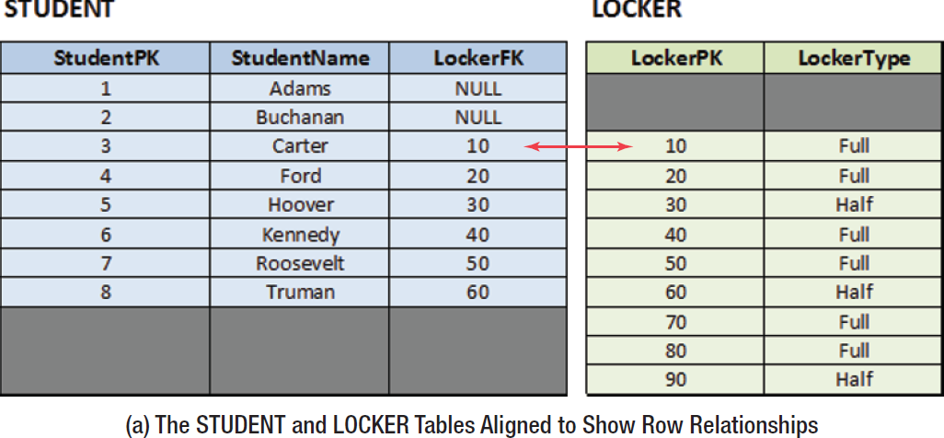
SQL for Data Retrieval: OUTER JOIN I
The OUTER JOIN syntax can be used to obtain data that exists in one table without matching data in the other table.
Figure 3-17: Types of Joins

Slide 45
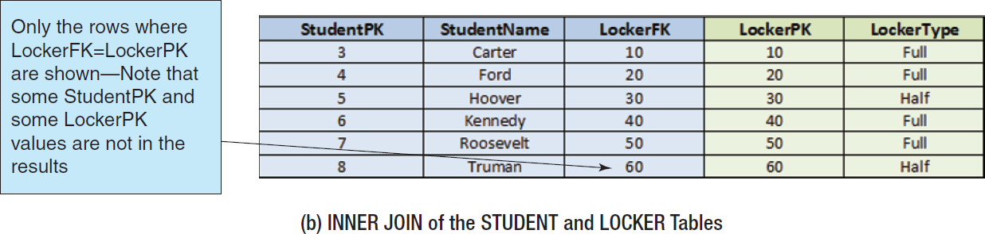
SQL for Data Retrieval: OUTER JOIN II
Figure 3-17: Types of Joins

Slide 46
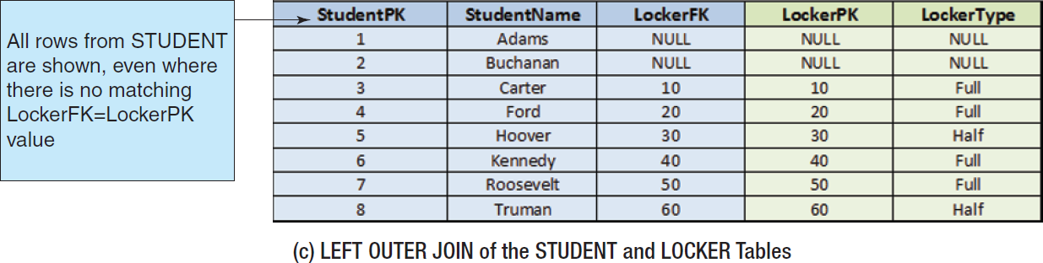
SQL for Data Retrieval: OUTER JOIN III
Figure 3-17: Types of Joins

Slide 47
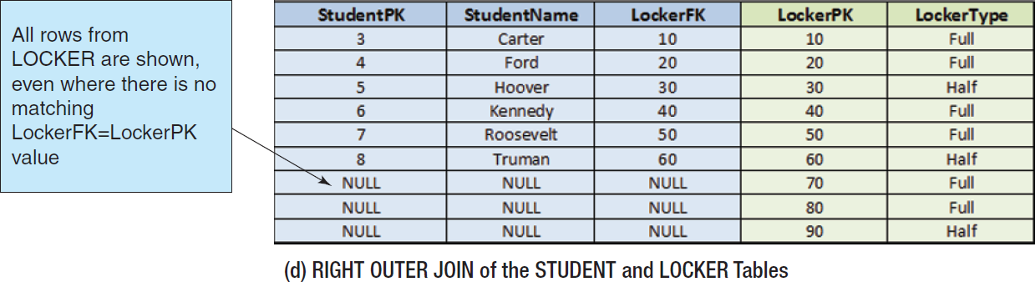
SQL for Data Retrieval: OUTER JOIN IV
Figure 3-17: Types of Joins

Slide 48
SQL for Data Retrieval: LEFT OUTER JOIN Example
The OUTER JOIN syntax can be used to obtain data that exists in one table without matching data in the other table.
SELECT EmpName
FROM EMPLOYEE AS E
LEFT JOIN DEPARTMENT AS D
ON E.DeptID = D.DeptID
WHERE D.DeptName LIKE 'Account%';

Slide 49
SQL for Data Retrieval: RIGHT OUTER JOIN Example
The unmatched data displayed can be from either table, depending on whether RIGHT JOIN or LEFT JOIN is used.
SELECT EmpName
FROM EMPLOYEE AS E
RIGHT JOIN DEPARTMENT AS D
ON E.DeptID = D.DeptID
WHERE D.DeptName LIKE 'Account%';

Slide 50
Modifying Data using SQL
Insert
Will add a new row in a table (already discussed above)
Update
Will update the data in a table that matches the specified criteria
Delete
Will delete the data in a table that matches the specified criteria

Slide 51
Modifying Data using SQL: Changing Data Values: UPDATE
To change the data values in an existing row (or set of rows) use the Update statement.
UPDATE EMPLOYEE
SET Phone '791-555-1234'
WHERE EmpID = 29;
UPDATE EMPLOYEE
SET DeptID = 44
WHERE EmpName LIKE 'Kr%';

Slide 52
Modifying Data using SQL: MERGE
SQL:2003 introduced the MERGE statement.
Combines INSERT and UPDATE into one statement
Uses the equivalent of IF-THEN-ELSE logic to decide whether to use INSERT or UPDATE
An advanced feature—learn to use INSERT and UPDATE separately first, then consult DBMS documentation

Slide 53
Modifying Data using SQL: Deleting Data: DELETE
To delete a row or set of rows from a table use the DELETE statement.
DELETE FROM EMPLOYEE
WHERE EmpID = 29;
DELETE FROM EMPLOYEE
WHERE EmpName LIKE 'Kr%';

Slide 54
Modifying Data using SQL: Deleting Database Objects: DROP
To remove unwanted database objects from the database, use the SQL DROP statement.
Warning… The DROP statement will permanently remove the object and all data.
DROP TABLE EMPLOYEE;

Slide 55
Modifying Data using SQL: Removing a Constraint: ALTER & DROP
To change the constraints on existing tables, you may need to remove the existing constraints before adding new constraints.
ALTER TABLE EMPLOYEE
DROP CONSTRAINT EmpFK;

Slide 56
Modifying Data Using SQL: The CHECK Constraint
The CHECK constraint can be used to create sets of values to restrict the values that can be used in a column.
ALTER TABLE PROJECT
ADD CONSTRAINT PROJECT_Check_Dates
CHECK (StartDate < EndDate);

Slide 57
SQL Views
A SQL View is a virtual table created by a DBMS-stored SELECT statement that can combine access to data in multiple tables and even in other views.
SQL views are discussed online in Appendix E.

Slide 58

DAVID M. KROENKE and DAVID J. AUER
DATABASE CONCEPTS, 7th Edition
All rights reserved. No part of this publication may be reproduced, stored in a retrieval system, or transmitted, in any form or by any means, electronic, mechanical, photocopying, recording, or otherwise, without the prior written permission of the publisher. Printed in the United States of America.
Copyright © 2015 Pearson Education, Inc.
Publishing as Prentice Hall

Slide 59
Structured Query Language
DAVID M. KROENKE and DAVID J. AUER
DATABASE CONCEPTS, 7th Edition
End of Presentation on Chapter Three

